Slide 1

Employee Lifestyle and Salary Analysis
An Exploratory Data Analysis Using Python/Excel

Slide 2
Objective:
Analyze how employee habits (healthy eating & active lifestyle) relate to salary and age.
Dataset Features:
id | Unique identifier
groups | Blood group
age | Age of the employee
healthy_eating | Score from 1 to 10
active_lifestyle | Score from 1 to 10
salary | Monthly or annual compensation

Slide 3
TABLE OF CONTENTS
01
02
03
04
05
06
Relationship Between Age and Salary
Relationship Between Healthy Eating and Active Lifestyle
Does Healthy Eating Affect Salary?
Distribution of Employee Salaries
Employee Group Distribution
High Healthy Eating + Low Salary

Slide 4
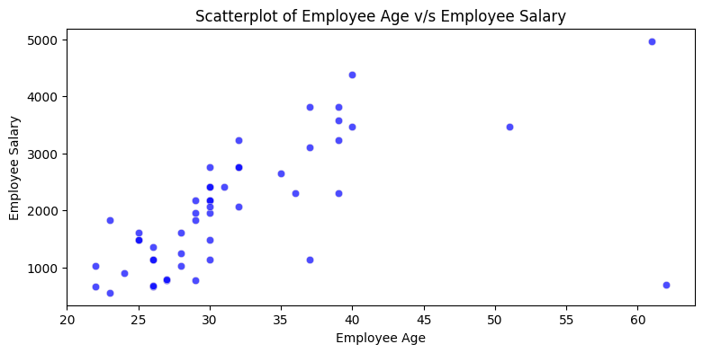
Relationship Between Age and Salary
Observations:
We observe that in general, there is a relationship between age and Salary of employee
As age increases, the Salary also increases , though there are some outliers present as well

Slide 5
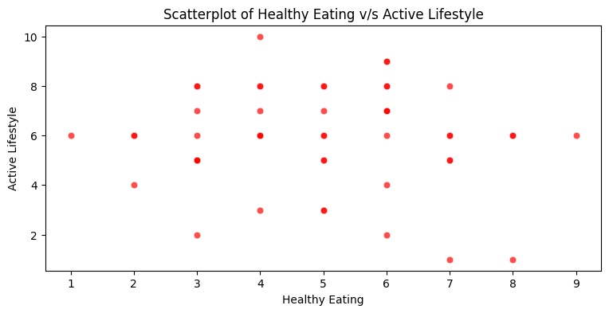
Relationship Between Healthy Eating and Active Lifestyle
Observations:
We observe that in general, there is a relationship between healthy_eating and active_lifestyle of employee
As healthy_eating increases, the active_lifestyle also increases

Slide 6
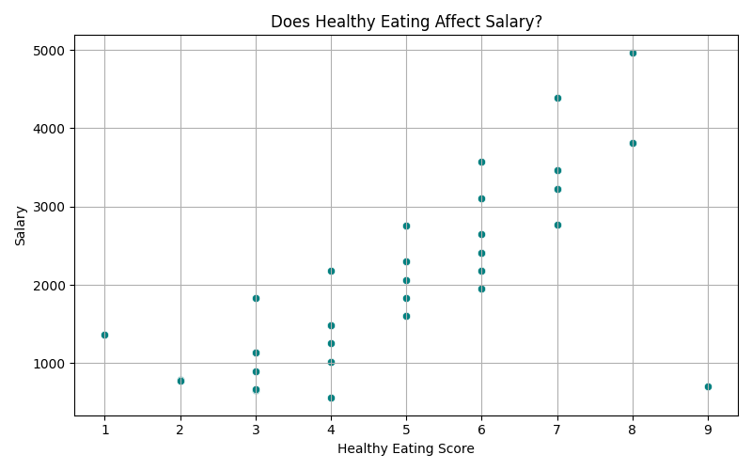
Does Healthy Eating Affect Salary?
Observation:
Positive correlation observed.
Employees with better eating habits tend to earn more.

Slide 7
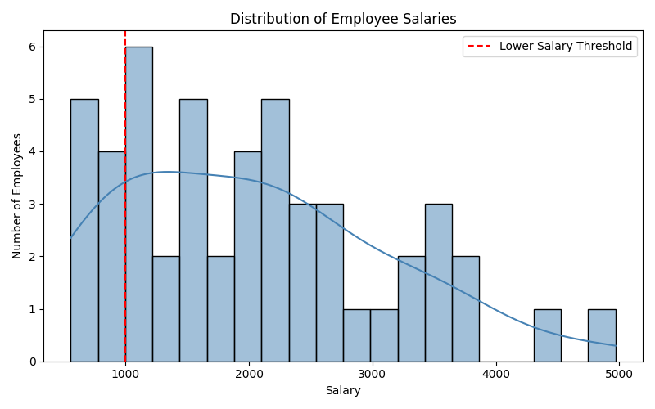
Distribution of Employee Salaries
Observation:
Salaries are spread across a wide range.
Skewed with some low earners under 1000.

Slide 8
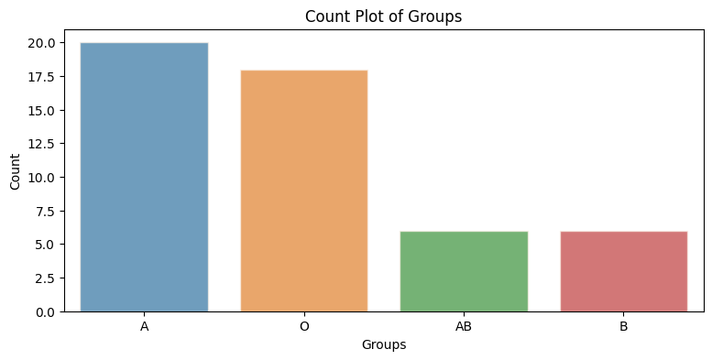
Employee Group Distribution
Observation:
We see that most employees either belong to Group A or Group O, with group A having maximum frequency

Slide 9
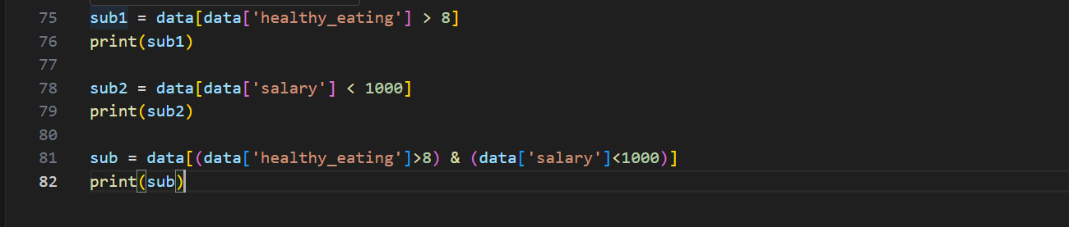
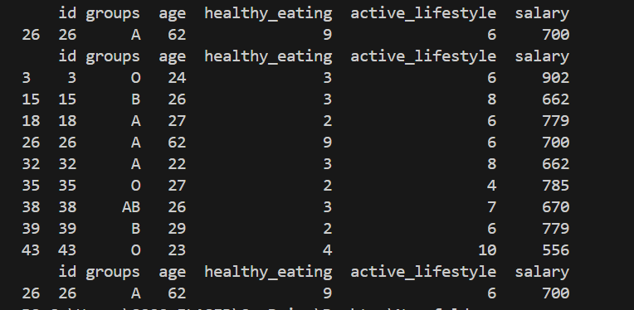
High Healthy Eating + Low Salary

Slide 10
Outlier Case – Salary vs Healthy Eating
Observation:
While analyzing the relationship between healthy eating habits and employee salary, we identified one notable outlier:
Employee ID: 26
Healthy Eating Score: High (above 8)
Salary: 700, which is significantly below the expected range for employees with high health scores.
Insight:
This employee breaks the general trend where higher healthy eating scores are typically associated with higher salaries.
The salary of 700 places this employee well below the average, indicating a possible discrepancy.
This could suggest:
1. A data entry issue
2. A unique job role or employment status (e.g., intern, part-time)
3. Or a potential area for compensation review.

Slide 11
Recommendations
1. Promote Health Initiatives Across All Salary Bands
2. Investigate Salary Discrepancies
3. Leverage Subset Insights for HR Strategy
Encourage healthy eating and active lifestyles for employees at all levels.
Consider incentive-based wellness programs to increase engagement and overall well-being.
Review cases where health-conscious employees earn below average, such as Employee ID 26.
Determine if these are due to:
Job roles (e.g., intern/contract)
Data quality issues
Potential oversight in salary structuring
Use identified data subsets (e.g., high healthy eating + low salary) to:
Target wellness support where it may be most needed
Inform future hiring, benefits, and retention policies
Promote a data-driven culture in HR and employee engagement initiatives

Slide 12

Conclusion
1. Lifestyle Factors Matter
Health-related habits like healthy eating and active lifestyles show subtle but meaningful correlations with employee compensation.
2. Health Metrics as Proxies
Even simple wellness indicators can provide valuable insights into the well-being and potential engagement levels of employees.
3. Future Analysis Potential
Integrating additional variables such as:
Performance ratings
Educational background
Job role or tenure can lead to deeper, more actionable insights.

Slide 13
THANKS!
I’d be happy to address any thoughts, feedback, or insights you may have.

